Slide 1
ABC Company

Slide 2
Business Goal
ABC Company Group have an existing restaurant Penang, Malaysia. It had been successful and ABC Company Group would like to open a branch around Petaling Jaya. Location is one of key factor to success of any restaurant

Slide 3
2. Data:
Postal codes and boroughs data in Petaling Jaya with all restaurant details
Latitude and Longitude details
Foursquare location API(Third party Tool) to get the venue details and some python packages

Slide 4
2. Data:
No | Restaurant Name
0 | Paya Serai Restaurant
1 | Genji Japanese Restaurant
2 | Yue Chinese Restaurant
3 | Imperial Garden Restaurant
4 | Sango Japanese Restaurant (三郷日本料理レストラン)
5 | Ume Tei Japanese Restaurant
6 | Oversea Restaurant (海外天大飯店)
7 | Restaurant Sederhana Petaling Jaya
8 | Restaurant Sri Saravana Curry House
9 | Restaurant BNS Maju Sdn. Bhd.
10 | A&W
11 | Restaurant Zone Eight White Coffee
12 | Restaurant Tou Tou, Seri Petaling
13 | Restaurant Chef rasa Sayang Kristal Sdn Bhd
14 | Toh Yuen Chinese Restaurant
15 | Restoran Syed Bistro
16 | Japanese Restaurant, PJ Hilton
17 | the italian restaurant @ BAC
18 | Ren Ren Bak Kut Teh Restaurant
19 | Pizza Hut Restaurant Sdn Bhd
20 | Rokaru Restaurant Pub
21 | The Janova Restaurant
22 | Chef Rasa Sayang Chinese Restaurant (中国餐馆)
23 | At HLT Restaurant (jinjang) Sdn Bhd 喜来登(增江)海鲜酒家
24 | Restoran Al Hayath
25 | Hilton restaurant
26 | Utara Coffee House
27 | Restoran Jaya
28 | Janova Banana Leaf Cuisine
29 | Gazebo Shah Village
No | Category | Total
1 | Asian Restaurant | 2
3 | Business Center | 1
4 | Chinese Restaurant | 6
5 | Fast Food Restaurant | 1
6 | Hotel Bar | 1
7 | Indian Restaurant | 5
8 | Indonesian Restaurant | 2
9 | Italian Restaurant | 1
10 | Japanese Restaurant | 4
11 | Malay Restaurant | 2
12 | Office | 1
13 | Pub | 1
14 | none | 3

Slide 5
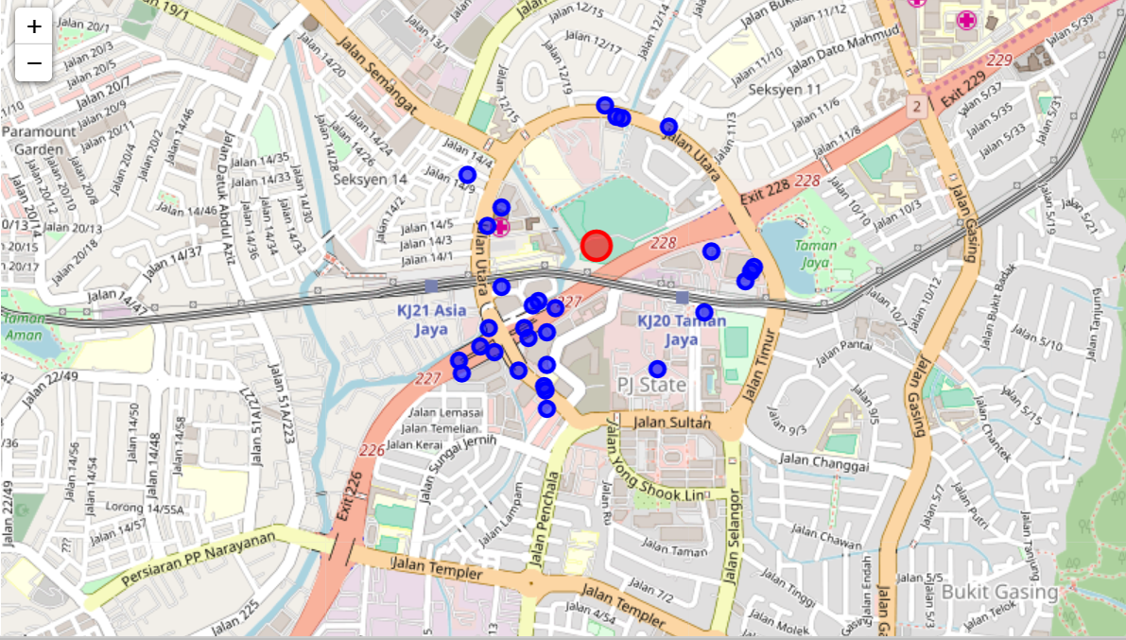
Geographical Representation

Slide 6
Result
Based on the result, we found out that in Petaling Jaya most popular categories of restaurant is Chinese Restaurant and Toh Yuen Chinese restaurant is get the best rating among them.
The results profoundly indicating that, ABC Group can consider to open Chinese restaurant in Petaling Jaya area.

